Slide 1
Telemarketing Data Analysis
Presenters:
LOH XIN YANG SITTIPHAN
VENKAT SUBRAMANIAN
MAPLE LIM YIN YIN
SITTI NURARFAZIRAH BINTE SHEIKH ARZIMI
CHEE WEI KIAT COLIN

Slide 2
Agenda
1
2
3
4
Introduction
Analysis
Recommendations
Conclusion

Slide 3
Introduction
LOH XIN YANG SITTIPHAN
Business Problem
Dataset, Data cleaning
Assumptions

Slide 4
Business Problem
LOH XIN YANG SITTIPHAN
Value
Problem
Goal
Covid-19
Legal Restriction
Improve Conversion Rate
Legal Restriction
Safe way to connect with new prospects
Eg. Do not Call Registry
Target the right people
Eg. Do not Call Registry
Human Interaction
Undesired
Reduce cost
Reduce cost
Build rapport and create trust
Think it is a scam call or too intrusive
Reduce unnecessary time and money spent
Reduce unnecessary time and money spent

Slide 5

Dataset, Data Cleaning
LOH XIN YANG SITTIPHAN
Bank Telemarketing Dataset from UCI Machine Learning Repository
No null or N/A values
For columns job, education and contact, “unknown” values were replaced with the mode of each column
New columns e.g. education_unknown created to distinguish between replaced values and original values
Corrected data types for each column
Reordered the level for month column

Slide 6

Important Assumptions
LOH XIN YANG SITTIPHAN
Negative balances mean that the customer either has a bank loan or bank overdraft.
The attribute “poutcome” has a value of “unknown” if the specific customer has not been contact before. But there are 2 customers who have been contacted before, but their “poutcome” is unknown as well. The team assumes that the outcome of customers for the campaign held previously were not known even until the end of the campaign.
Only the variables in the dataset affects the outcome

Slide 7

Analysis
Exploratory Data Analysis
Methodology and Segmentation
Modelling
Evaluation

Slide 8
Exploratory Data Analysis
VENKAT SUBRAMANIAN
Power BI Demonstration

Slide 9
Methodology and Segmentation
VENKAT SUBRAMANIAN
Methodology
Evaluate models based on sensitivity followed by accuracy
Aim: Classify deposit variable into “yes” or “no”
Split into 70% train set and 30% test set

Slide 10
Methodology and Segmentation
MAPLE LIM YIN YIN
Customer Segmentation
Dataset includes variables only known after the call
Segment based on the details known prior to the call
Use K means clustering with age and balance_log
Optimal number of clusters = 3
Notes:
Thank you venkat
Now ill touch on customer segmentation
Because the dataset includes variables that are only known after the call for example duration of the call, (click) we made a more generalised segmentation based on the details that they have prior to their first call. (click) So we performed K-means Clustering with age and the balance log. (click) The results showed that the optimal number of clusters is 3

Slide 11
Modelling: Logistic Regression
MAPLE LIM YIN YIN
Stage 1
Stage 3
Stage 5
Stage 7
Train on Train set
Reduce AIC using step function
Probability > 50% → yes
Probability < 50% → no
CART shows a better threshold is 47%
Stage 2
Stage 4
Stage 6
Stage 8
Train set has no missing values
Test on Test set
Accuracy: 83.4% Sensitivity: 82.4 %
Accuracy: 83.7%
Sensitivity: 84.3%
Notes:
We made multiple models to see which model makes the best classification.
First, we developed the logistic regression model. The model is trained on a trainset that has no missing values because logistic regression cannot handle missing values. Then, we reduce the AIC to the minimum by using the step function before testing it on the test set. Using the threshold of 50%, we got an accuracy of 83.4% and sensitivity of 82.4%.
To improve the model, the

Slide 12
Modelling: MARS
MAPLE LIM YIN YIN
Stage 1
Stage 3
Stage 5
Stage 7
Train on Train set
with no missing values
Probability > 50% → yes
Probability < 50% → no
Improve model:
Using 10 fold CV
Maximizing accuracy
Stage 2
Stage 4
Stage 6
Stage 8
Build using logistics regression
Accuracy: 83.8% Sensitivity: 82.7%
Notes:
Find the optimal degree and nprune by maximising accuracy and by using 10cv

Slide 13
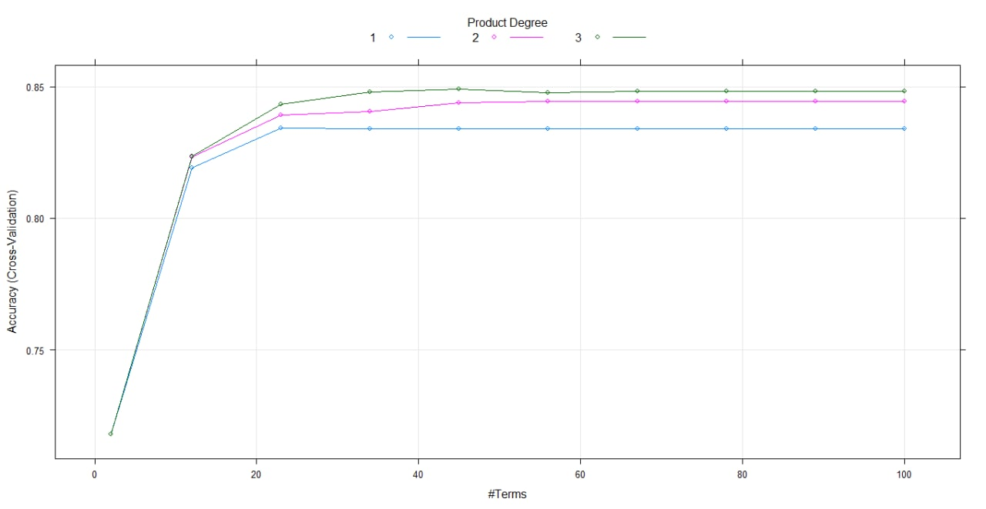
Modelling: MARS
MAPLE LIM YIN YIN
Notes:
Choose the third degree and nprune of 45 because it has the highest accuracy

Slide 14
Modelling: MARS
MAPLE LIM YIN YIN
Stage 1
Stage 3
Stage 5
Stage 7
Train on Train set
with no missing values
Probability > 50% → yes
Probability < 50% → no
Improve model:
Using 10 fold CV
Maximizing accuracy
Improve model:
CART shows a better threshold is 39%
Stage 2
Stage 4
Stage 6
Stage 8
Build using logistics regression
Accuracy: 83.8% Sensitivity: 82.7%
Optimal degree = 3
Optimal nprune = 45
Accuracy: 85.7%
Sensitivity: 90.1%
Notes:
Find the optimal degree and nprune by maximising accuracy and by using 10cv

Slide 15
Modelling: CART
MAPLE LIM YIN YIN
Stage 1
Stage 3
Stage 5
Train on Train set
Grow the tree to its maximum (cp=0)
Accuracy: 83.7%
Sensitivity: 86.5%
Stage 2
Stage 4
Train set includes missing values
Prune the tree to make it smaller (cp=0.0024)

Slide 16
Modelling: Random Forest
MAPLE LIM YIN YIN
Stage 7
Stage 1
Stage 3
Stage 5
Train on 2 Seperate Train sets
Accuracy: 85.7%
Sensitivity: 89.4%
Accuracy: 84.9%
Sensitivity: 88.4%
Tune random forest of 500 trees with mtry=10 and 10 fold CV
Stage 2
Stage 4
Stage 6
Stage 8
1. Use train set from dataset created by team
2. Use train set from rfImpute function
Use dataset created by team
Accuracy: 85.8%
Sensitivity: 88.7%
Notes:
2 separate trainsets because Random forest is able to handle missing values in 2 ways, one of them is to fill the missing values based on the mode of the column, which we did to replace the missing values in the dataset
the other way is to predict using the rfImpute function.

Slide 17
Modelling: Neural Network
MAPLE LIM YIN YIN
Stage 1
Stage 3
Stage 5
Train on Train set
Train without normalisation
Train with normalisation
Stage 2
Stage 4
Stage 6
Train set has no missing values
Accuracy: 81.8%
Sensitivity: 84.3%
Accuracy: 53.5%
Sensitivity: 81.2%

Slide 18
Evaluation
MAPLE LIM YIN YIN
Model | Accuracy (%) | Sensitivity (%) | Specificity (%)
Logistic Regression | 83.7 | 84.3 | 83.1
Tuned MARS | 85.7 | 90.1 | 80.1
CART | 83.7 | 86.5 | 81.2
Random Forest | 85.7 | 89.4 | 82.5
Neural Network | 81.8 | 84.3 | 79.5
Chose model with the highest sensitivity
Notes:
As explained in the methodology, we prioritize the sensitivity metric. You can see in this table that tuned MARS has the highest sensitivity. Plus, the accuracy is not too low too.
Therefore, the tuned mars is selected for making recommendations

Slide 19
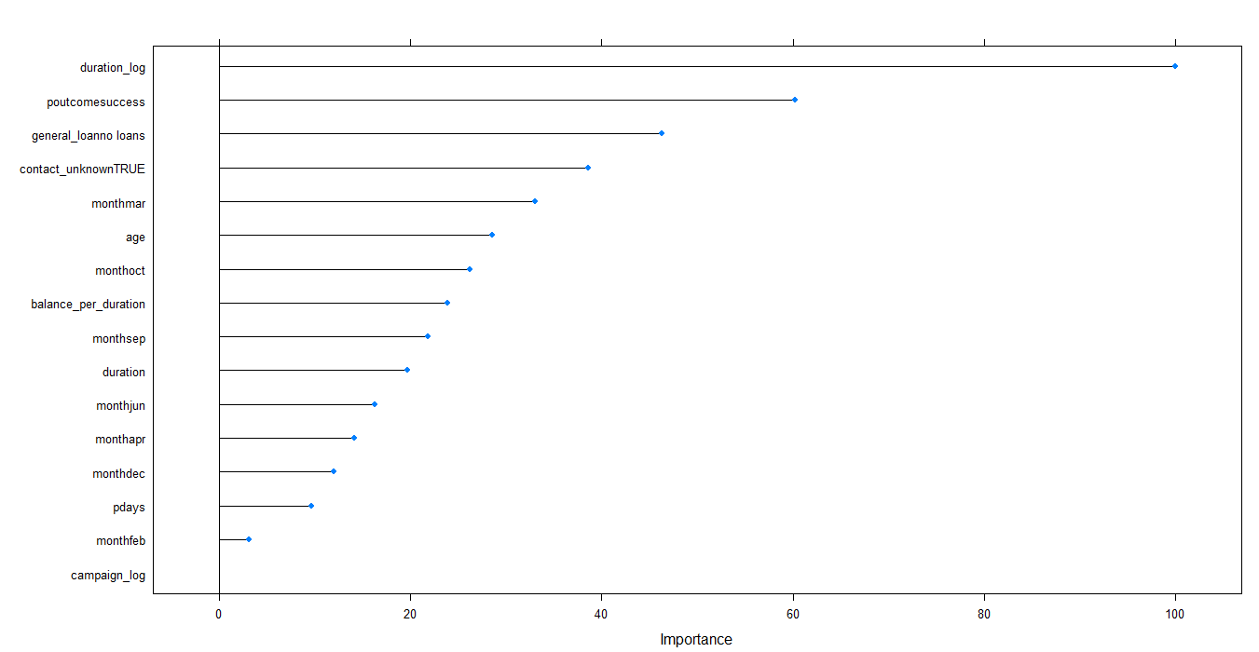
Results of Tuned MARS Model
MAPLE LIM YIN YIN
Notes:
Shows the importance of feature engineering because duration_log plays a very important role

Slide 20

Recommendations
SITTI NURARFAZIRAH
Enhance Customer Targeting
Improve Competencies and Systems

Slide 21

Enhance Customer Targeting based on:
SITTI NURARFAZIRAH
Seasonality
Loan Status & Job/Age Group
Results of previous campaign
Expected duration to win a prospect

Slide 22
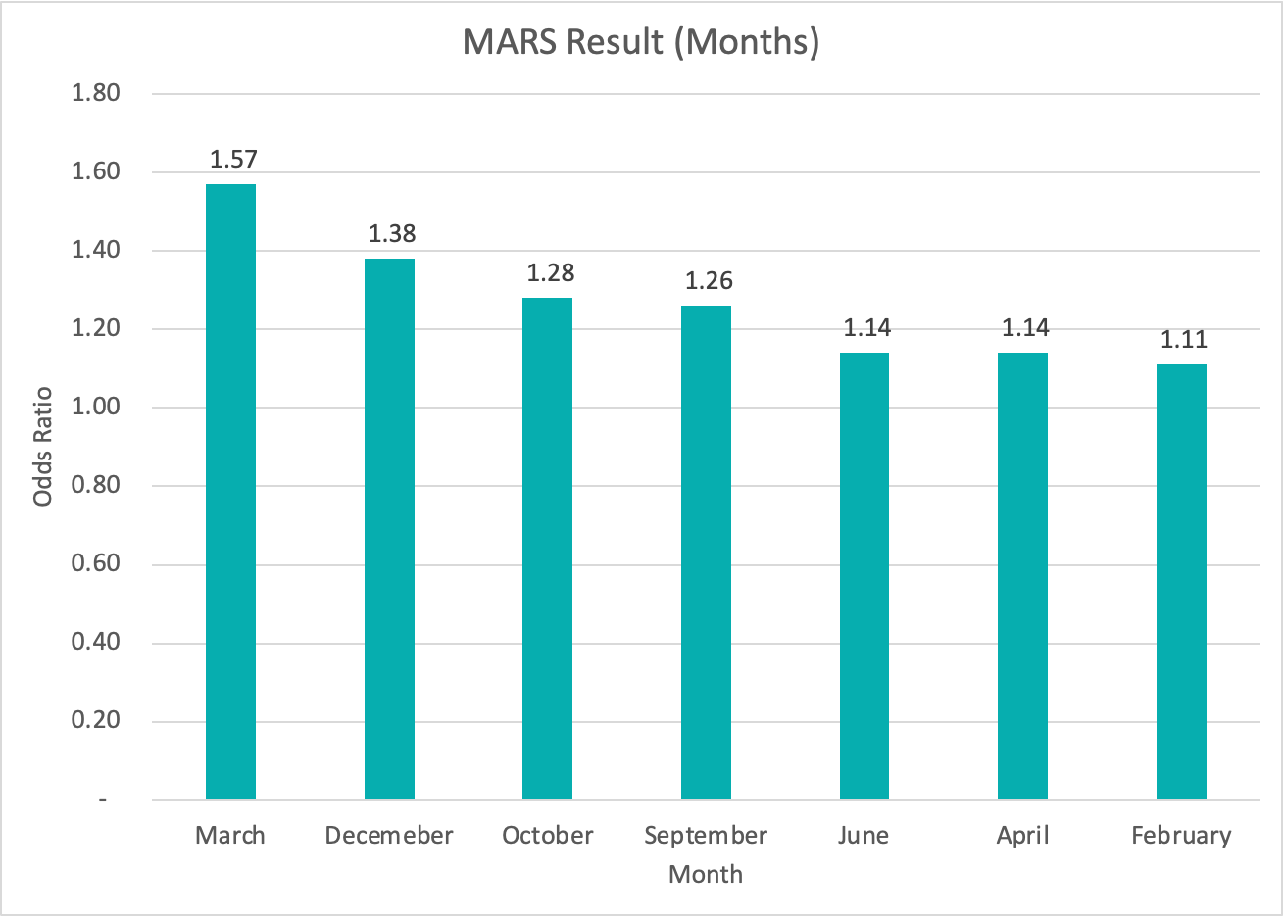
Seasonality: Feb, Mar, Apr, Sept, Oct, Dec
SITTI NURARFAZIRAH

Slide 23
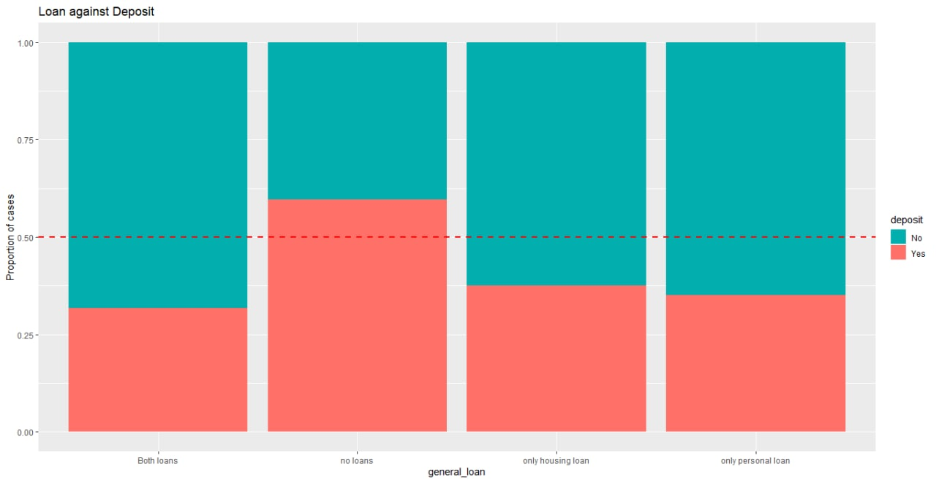
Loan Status
SITTI NURARFAZIRAH

Slide 24
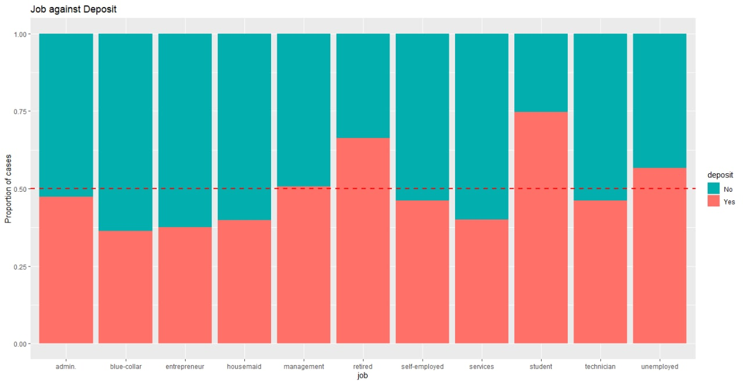
Job/Age Group
SITTI NURARFAZIRAH

Slide 25
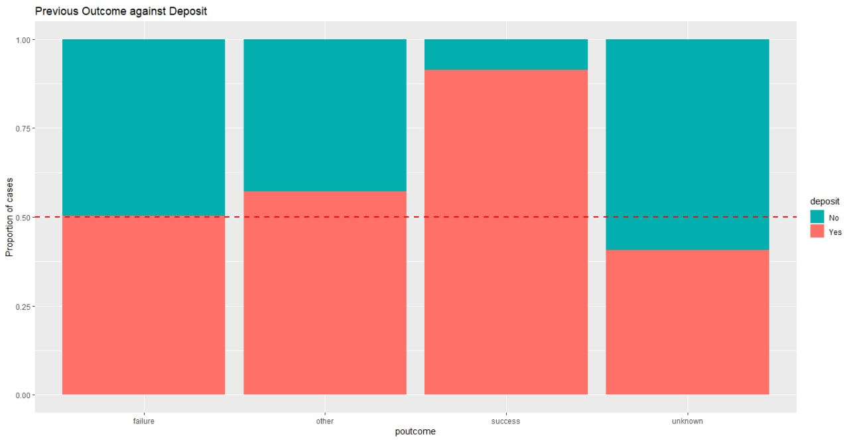
Result of Previous Campaign
SITTI NURARFAZIRAH
Prospects who were previous customers tend to say “Yes” to deposit
Focus on existing customers when trying to market new campaigns
Frequency of calls to existing customers should be kept to a minimum

Slide 26
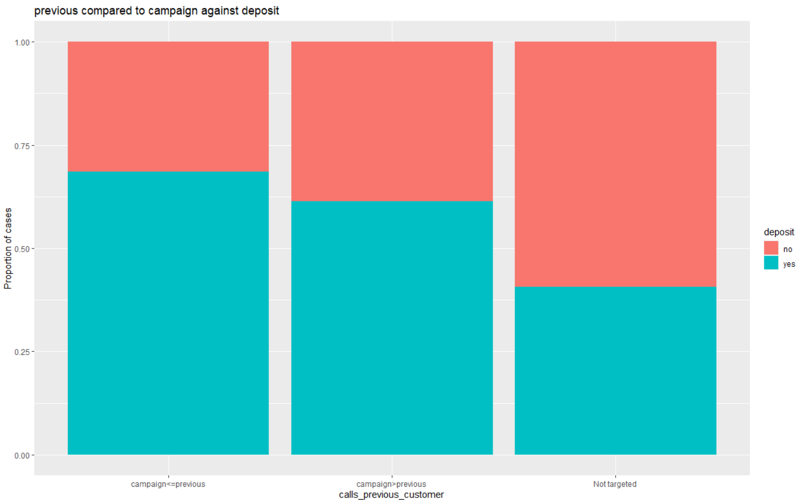
Result of Previous Campaign
SITTI NURARFAZIRAH
Prospects who were previous customers tend to say “Yes” to deposit
Focus on existing customers when trying to market new campaigns
Frequency of calls to existing customers should be kept to a minimum

Slide 27

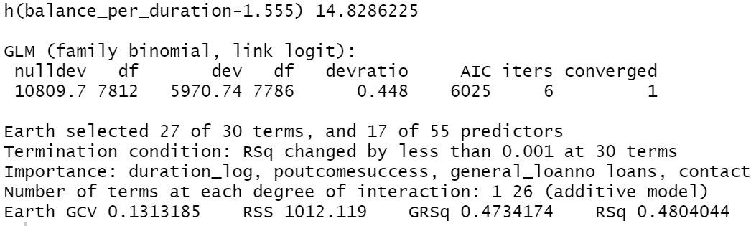
Expected duration to win a prospect
SITTI NURARFAZIRAH
balance_per_duration best to be greater than 1.555 for a prospect to be won
Derive expected duration of call to win a prospect based on balance
Prioritise prospects based on expected duration to increase efficiency

Slide 28

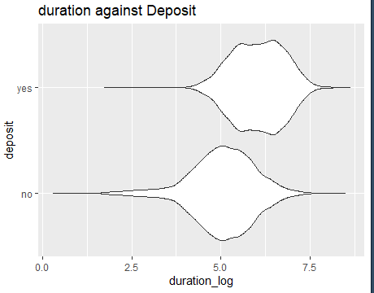
Improve competencies and systems
SITTI NURARFAZIRAH
Standardised well-crafted scripts
Scripts enhance engagement between telemarketer and prospects
Lengthy enough to match optimal duration (57 seconds) to increase likelihood of closing
Hiring of skilled employees
Source for telemarketers with good track record in converting prospects
Launch training programs to develop telemarketing skills of current employees

Slide 29

Discussions
CHEE WEI KIAT COLIN
Limitations
Applicability
Summary

Slide 30
Limitations
CHEE WEI KIAT COLIN
Variables
Legal Restriction
Duration
Duration of current calls are unknown until call is finished
Customer’s decision to make a deposit is not known
Model only generated by fixed amounts of variables in dataset
There are other possible variables affecting Y that is not in the dataset
Eg. Do not Call Registry
MARS
Normalization
Not as intuitive as
CART and regression
Difficult to interpret results for those with no statistics background
Usage of automated functions such as Gaussianize
Harder to calculate exact splitting points

Slide 31


Applicability of MARS to other industries
CHEE WEI KIAT COLIN
Real Estate
B2B
Determine which owner to call based on how likely to sell a property
Determine which business to call based on how likely to do business
Based on important variables such as:
Based on important variables such as:
Value of Property
Revenue (balance)
Age, Occupation, Salary
Number of Loans (General loans)
Location of Property
Industry of Business (Job)

Slide 32

Applicability of MARS to other types of marketing
CHEE WEI KIAT COLIN
Digital Marketing
Influencer Marketing
Determine target audience based on likelihood of conversion
Determine whether a follower would purchase an advertised product
Based on important variables such as:
Based on important variables such as:
User targeted before? (Previous)
Demographic of follower (age/job)
Number of clicks on previous ad (Campaign)
Visits to influencer profile (Previous)
Duration of site visit (Duration)
Duration of viewing a post (Duration)

Slide 33
Summary
CHEE WEI KIAT COLIN
1. Develop a model to increase the efficiency and effectiveness of telemarketing through improving the conversion rate
2. Evaluated possible models and decided that a tuned MARS model will achieve our goal
3. Identified mean duration as the most important variable in predicting conversations
4. Limitations would affect the accuracy and sensitivity of our model
5. Our model has strong applicability in other industries and types of marketing

Slide 34
Thank you

Slide 35
Appendix

Slide 36
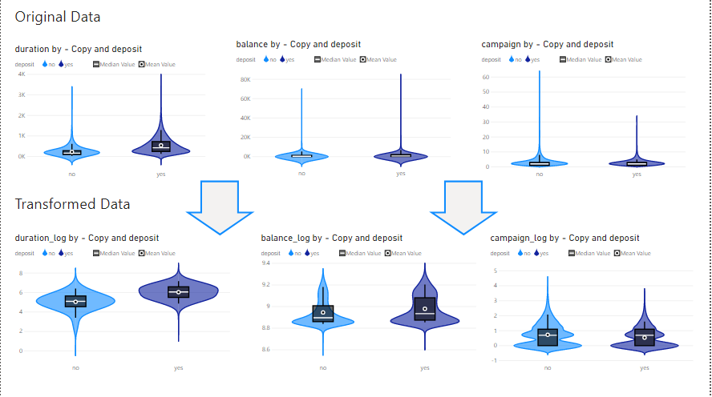
Exploratory Data Analysis - Important Findings

Slide 37
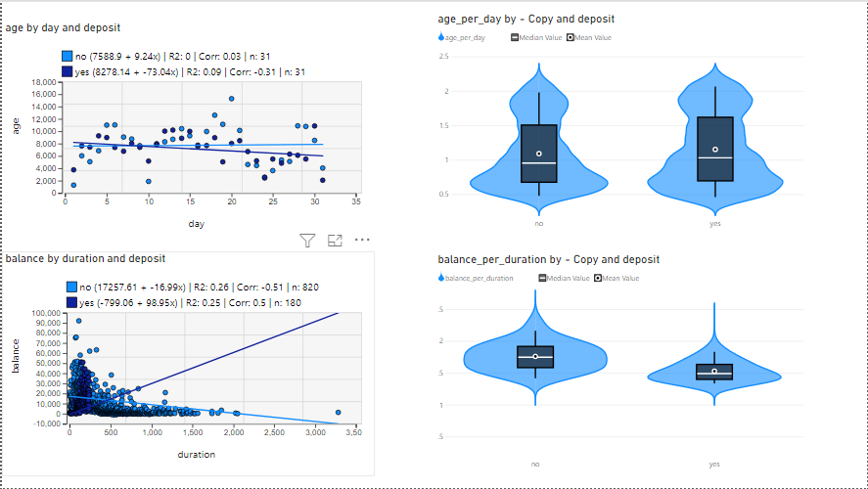

Slide 38
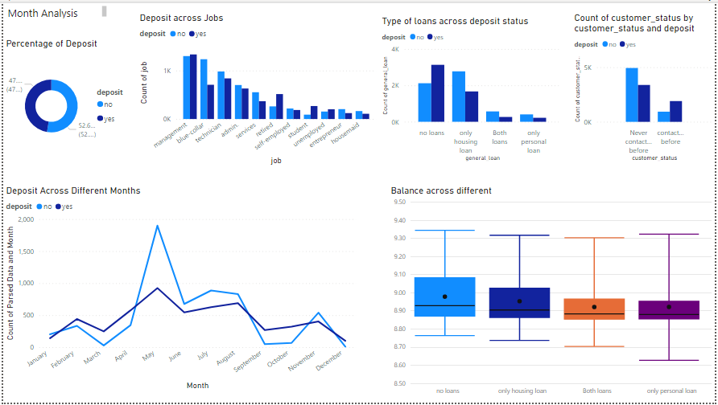

Slide 39
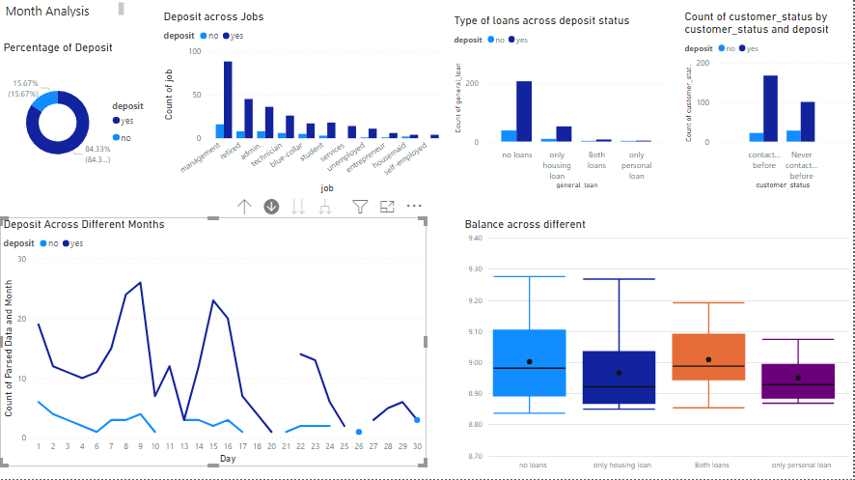
Popular Month (sep)

Slide 40
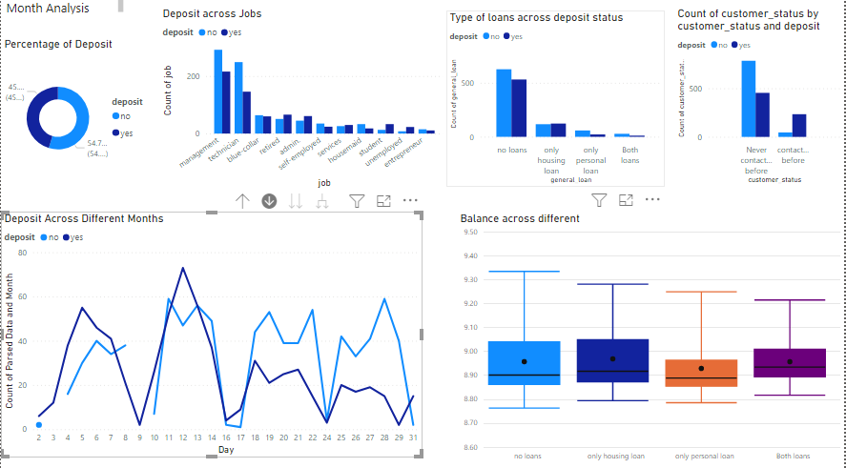
Unpopular month - August

Slide 41
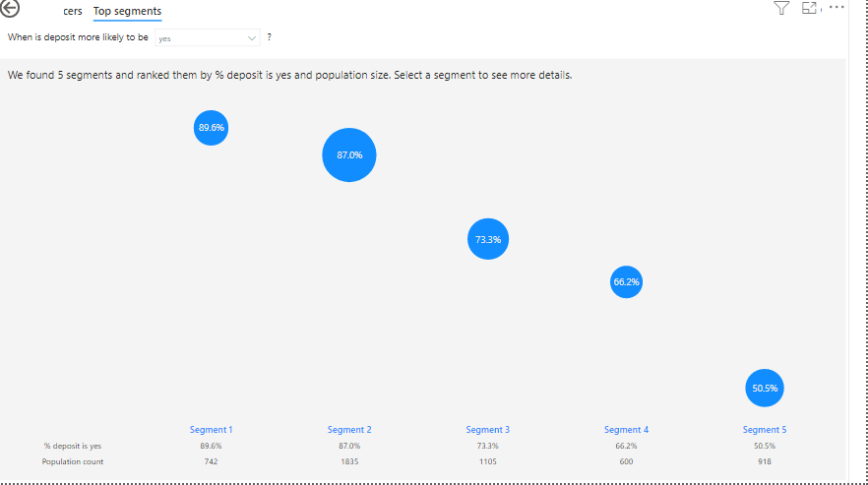

Slide 42
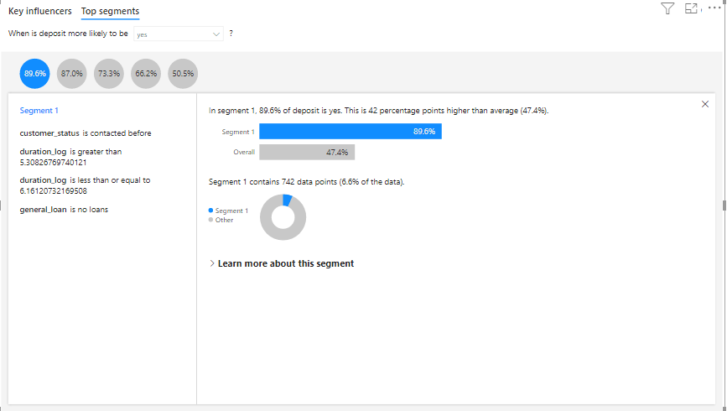

Slide 43
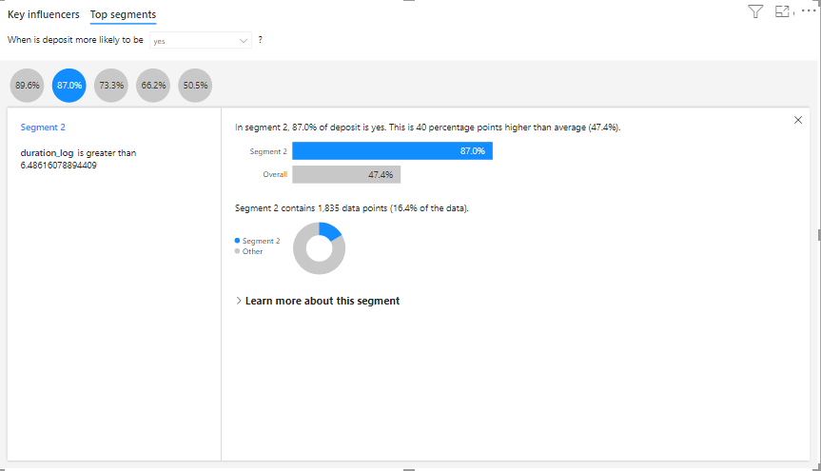

Slide 44
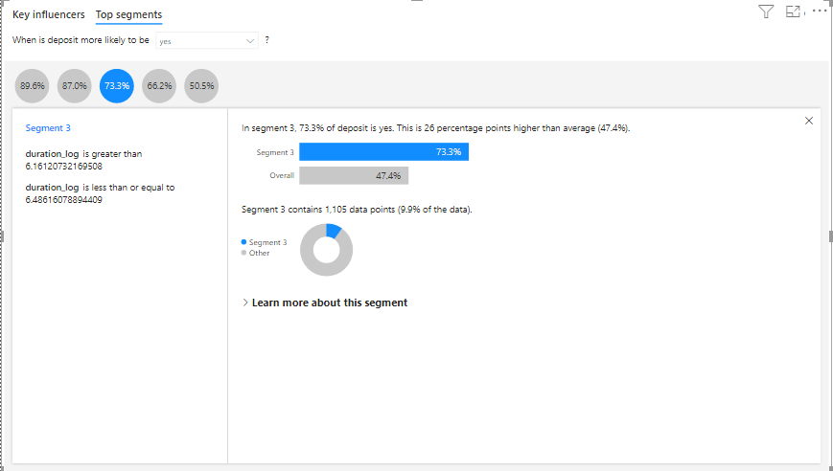

Slide 45
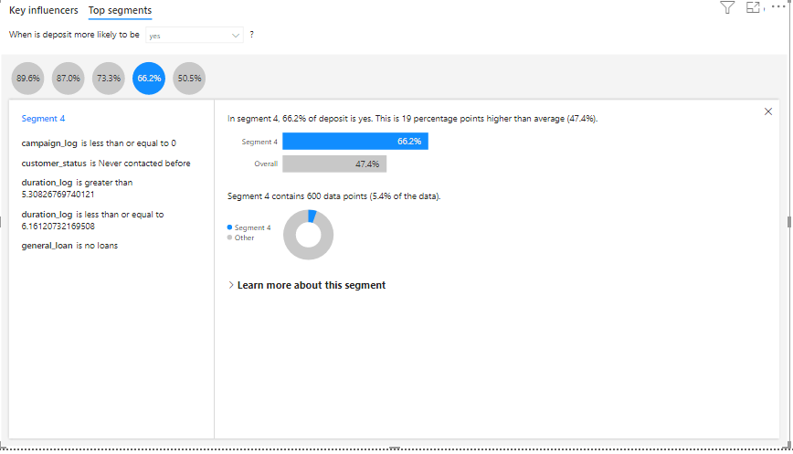

Slide 46
